Slide 1


AtliQ Hardware
Consumer Goods
Ad-Hoc Insights
P R E S E N T E D B Y :
S H I V E N D R A C H A U R A S I A

Slide 2


AtliQ Hardware
CONTENTS
About the Company | 3
About Objectives | 4
Company’s Market | 5
Request 1-10 | 6-15
Conclusion | 16

Slide 3


About the Company
AtliQ Hardware is a Computer Hardware and Accessory Manufacturer.
The Company manufactures products under 3 major divisions i.e., Networking and Storage, PC, Peripherals & Accesories
AtliQ Hardware is operational in NA, LATAM, EU and APAC regions

Slide 4




AtliQ Hardware (fictitious corporation) is one of the major computer hardware manufacturers in India, with a strong presence in other nations.
Nevertheless, the management did note that they do not have sufficient insights to make prompt, wise, and data-informed judgments.
ABOUT
Objectives
Plan to expand the data analytics team by adding junior data analysts.
The company seeks insights for 10 ad hoc requests
To assess candidates, Data analytics director, Tony Sharma plans to conduct a SQL Challenge to evaluate both tech and soft skills

Slide 5
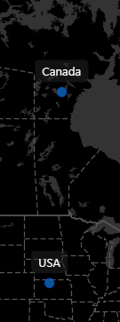
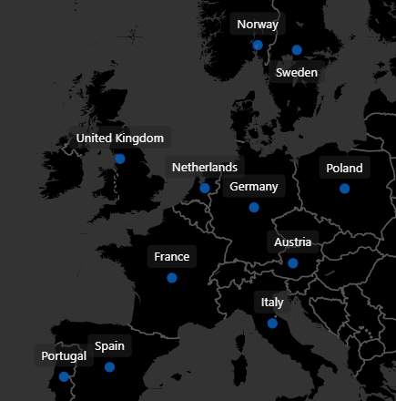
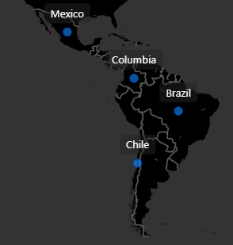
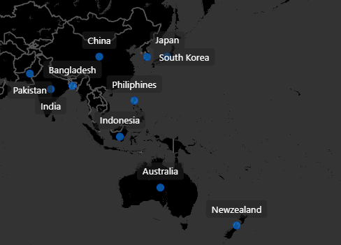
Company’s Market
NA
EU
AtliQ Hardware operates across four major regions: North America (NA), Latin America (LATAM), Europe (EU), and Asia Pacific (APAC). This global presence allows AtliQ to serve diverse customer needs with products in Networking and Storage, PCs, Peripherals and Accessories.
In NA and EU, AtliQ benefits from strong demand for Advanced Computing Solutions. LATAM and APAC, with their growing economies, offer Significant Opportunities for Expansion. This strategic positioning ensures AtliQ's sustained growth and customer satisfaction worldwide.
LATAM
APAC

Slide 6

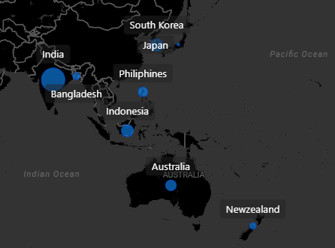
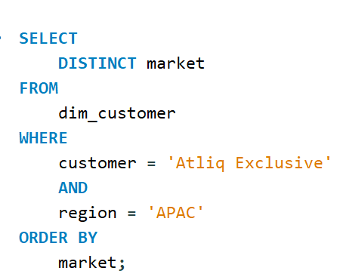
Request #1: Provide the list of markets in which customer "Atliq Exclusive" operates its business in the APAC region.

Slide 7
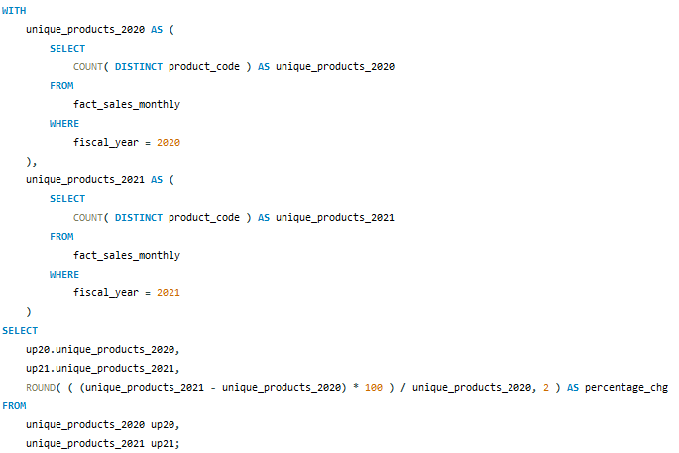
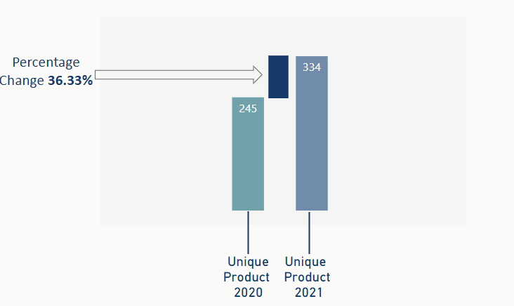
Request #2: What is the percentage of unique product increase in 2021 vs. 2020? The final output contains these fields: unique_products_2020, unique_products_2021 and percentage_chg

Slide 8
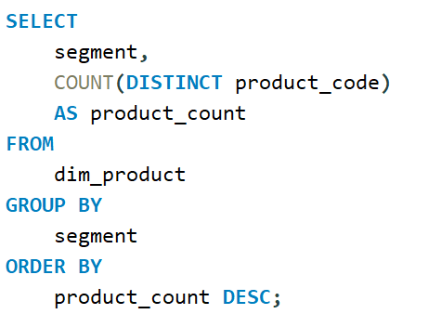
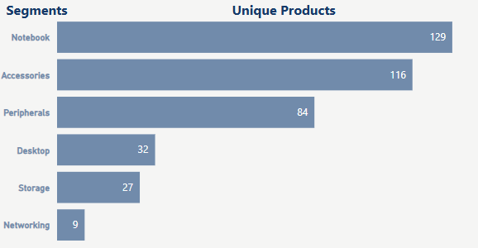
Request #3: Provide a report with all the unique product counts for each segment and sort them in descending order of product counts. The final output contains 2 fields: segment and product_count

Slide 9
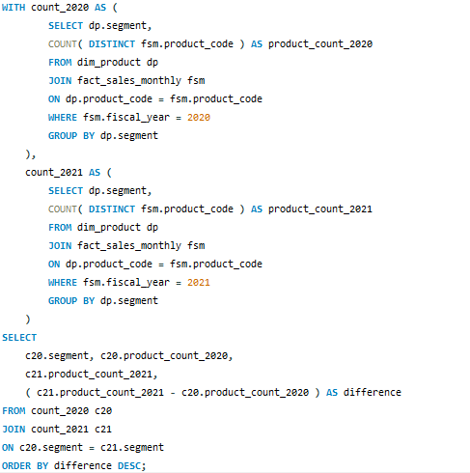
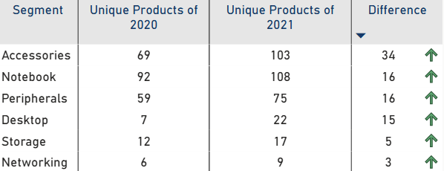
Request #4: Follow-up: Which segment had the most increase in unique products in 2021 vs 2020? The final output contains these fields: segment product_count_2020 product_count_2021 difference

Slide 10
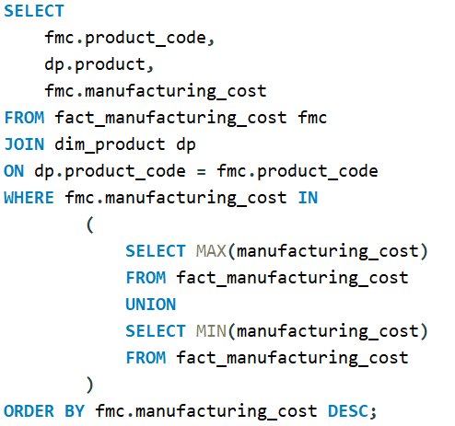
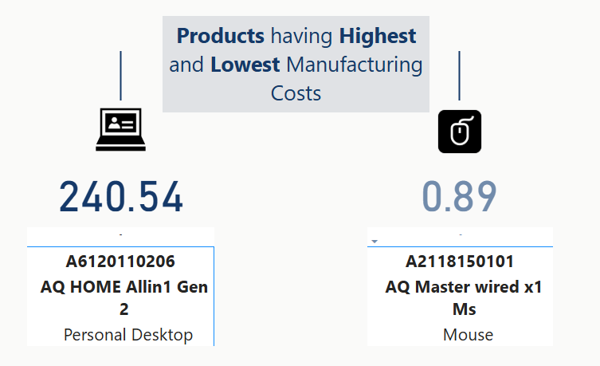
Request #5: Get the products that have the highest and lowest manufacturing costs. The final output should contain these fields: product_code product manufacturing_cost

Slide 11
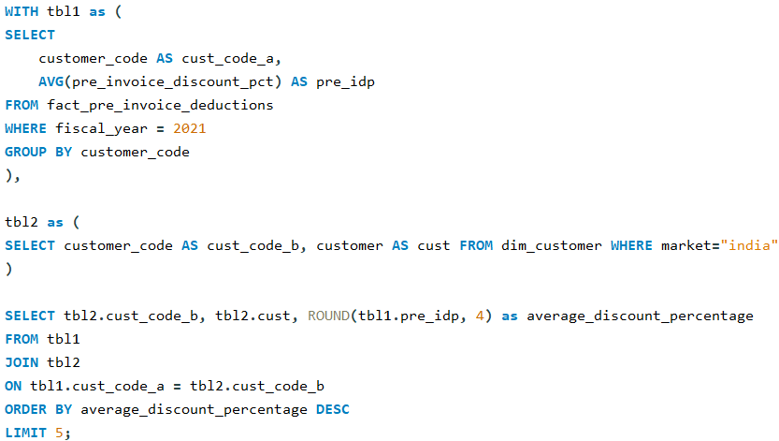
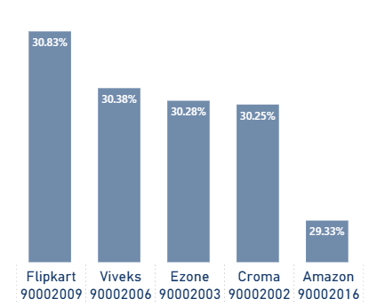
Request #6: Generate a report which contains the top 5 customers who received an average high pre_invoice_discount_pct for the fiscal year 2021 and in the Indian market. The final output contains these fields: customer_code, customer and average_discount_percentage

Slide 12
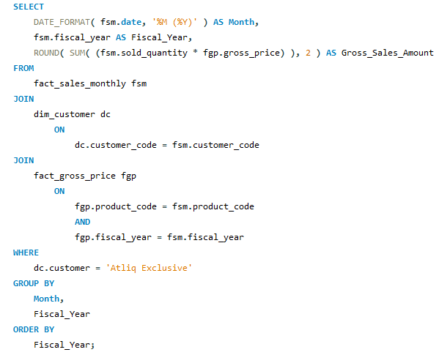
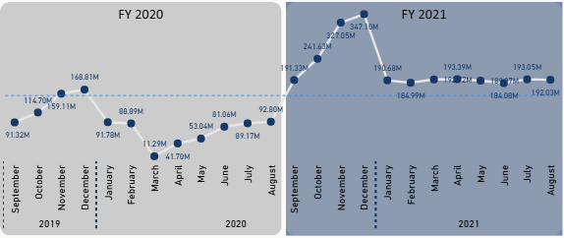
Request #7: Get the complete report of the Gross sales amount for the customer “Atliq Exclusive” for each month. This analysis helps to get an idea of low and high performing months and take strategic decisions. The final report contains these columns: Month, Year and Gross sales Amount

Slide 13
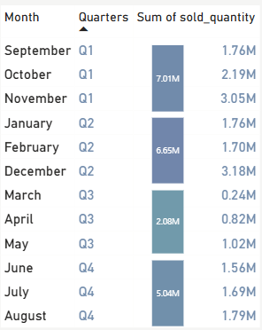
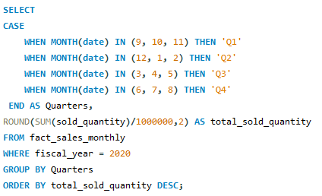
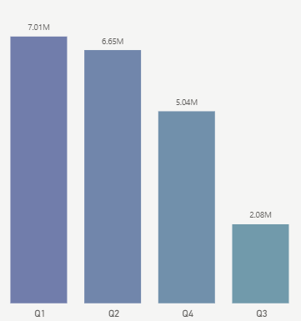
Request #8: In which quarter of 2020, got the maximum total_sold_quantity? The final output contains these fields sorted by the total_sold_quantity: Quarter, total_sold_quantity

Slide 14
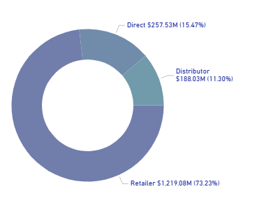
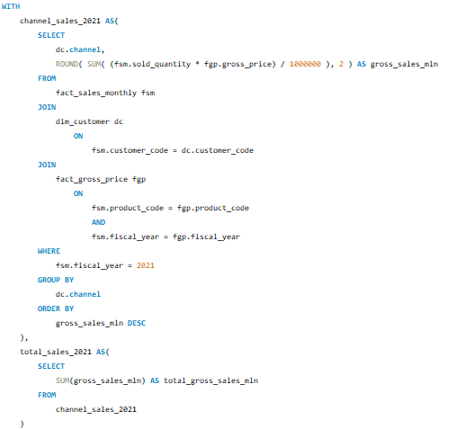
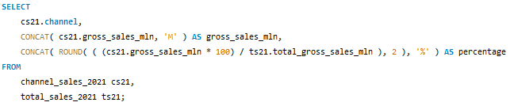
Request 9: Which channel helped to bring more gross sales in the fiscal year 2021 and the percentage of contribution? The final output contains these fields: channel, gross_sales_mln and percentage

Slide 15
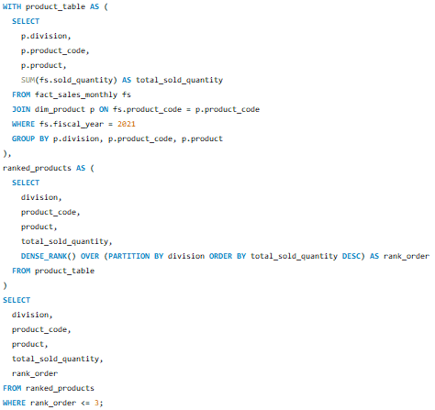
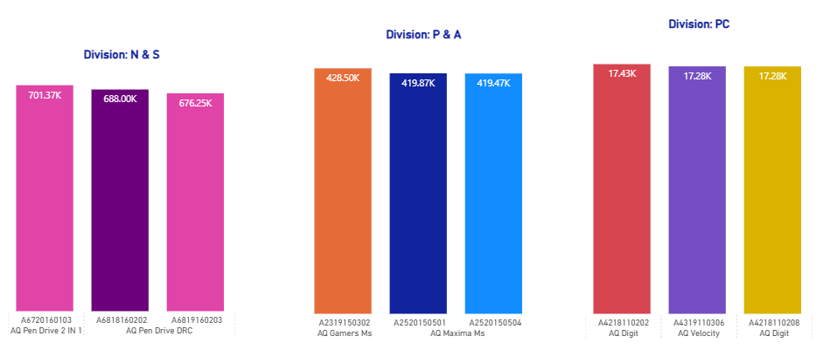
Request #10: Get the Top 3 products in each division that have a high total_sold_quantity in the fiscal_year 2021? The final output contains these fields: division, product_code, product, total_sold_quantity and rank_order

Slide 16
T H A N K Y O U

